Slide 1
Metis Project 1: Exploratory Data Analysis (EDA)
By: Team 5
Sean Davern, Scott Kroeger, Kristen Tokunaga
Notes:
Good Afternoon
My name is
My partners and fellow presenters are Kristen TOkunaga and Scott Kroeger

Slide 2
Harnessing Data Analytics to Benefit WomenTechWomenYes International
Street teams Placement Plan
↑ Awareness ↑ Sign ups
↑ Gala attendance
↑$
Notes:
During this presentation we’re going to present our recommendations for a street team placement plan. The focus of the plan is to optimize the effectiveness of street teams who are working to:
increase awareness of WomenTechWomenYes International and
convert that awareness into a willingness for people to provide their email address perhaps in exchange for free tickets to WTWY's annual gala
besides increasing gala attendance this helps find individuals passionate about increasing participation of women in technology,
to work toward WTWY objectives and increase WTWY fund raising
Problem = Motivation, Objective, Goals
An email exchange with a client
Chad, Cliff and Roberto -
It was great to meet with you and chat at the event where we recently met and had a nice chat. We’d love to take some next steps to see if working together is something that would make sense for both parties.
As we mentioned, we are interested in harnessing the power of data and analytics to optimize the effectiveness of our street team work, which is a significant portion of our fundraising efforts.
WomenTechWomenYes (WTWY) has an annual gala at the beginning of the summer each year. As we are new and inclusive organization, we try to do double duty with the gala both to fill our event space with individuals passionate about increasing the participation of women in technology, and to concurrently build awareness and reach.
To this end we place street teams at entrances to subway stations. The street teams collect email addresses and those who sign up are sent free tickets to our gala.
Where we’d like to solicit your engagement is to use MTA subway data, which as I’m sure you know is available freely from the city, to help us optimize the placement of our street teams, such that we can gather the most signatures, ideally from those who will attend the gala and contribute to our cause.
The ball is in your court now—do you think this is something that would be feasible for your group? From there we can explore what kind of an engagement would make sense for all of us.
Best,
Karrine and Dahlia
WTWY International
Draft Proposal:
WTWY street teams
Problem statement:
WTWY needs to optimize their street teams so that they can get the most email signups for their annual OMGYN Gala. Ideally, the email signups will convert at a high rate to gala attendees, and among attendees, many will make contributions to WTWY.
MTA data obtained from the NYC Data Portal provides rich information about the travel patterns of New Yorkers -- using this information, can we create a street team deployment plan that will optimize WTWY’s resources toward achieving their goals?

Slide 3

Methods
We Combined/Analyzed Data From:
Spring 2019 MTA Subway Usage
Subway Station Locations
Tech Sector Location Research
Identify Subway Stations with both:
Highest probability for finding tech employees
Highest traffic volumes
Notes:
High-Traffic Subway Entrances
Obtain: MTA Subway Data for Feb/Mar 2019
Scrub:
Entry/Exit Cumulative Values
Subway Station Locations
Explore: Entries & Exits
Karrine & Dahlia -
Hope you are well! We pulled the mta data from the public data portal and ran some initial feasibility analyses. Check out the attached document. With the MTA data alone, we can definitely help you to find places to deploy your teams to access the most people per day. We also included a few more ideas of different scales that would greatly improve the effectiveness our analyses could have toward achieving your goals.
Let us know what you think—we can set up a call to go through this with you, maybe this Thursday or Friday after 3?

Slide 4
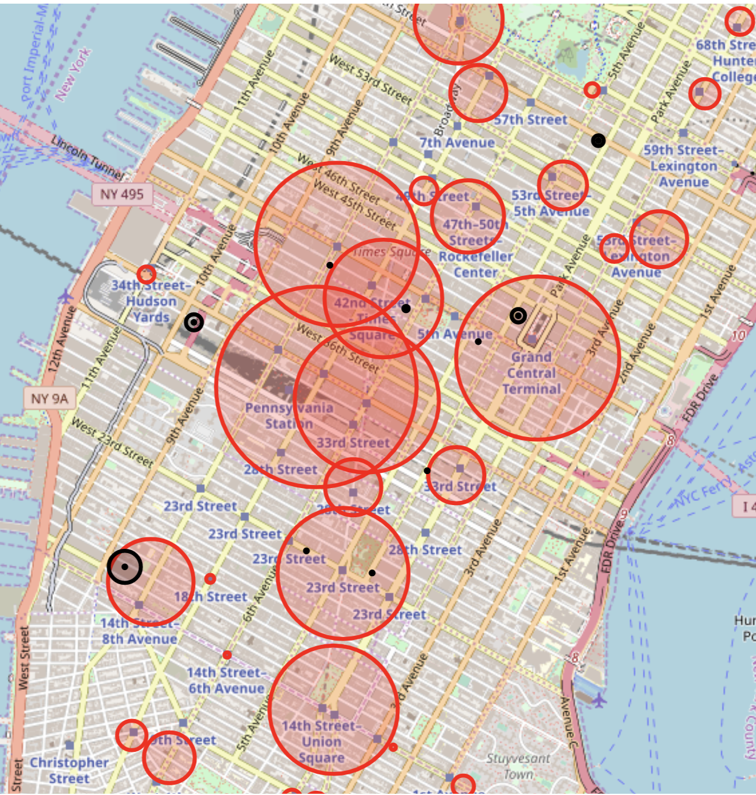
Results
High Traffic + Near Tech Hubs
Grand Central
High Traffic + Near Tech Hubs
86th St
Notes:
Subway Station Traffic: by Average Daily Turnstile “Entrances”
Technology Companies (sample of 15 locations): by square footage
Technology Schools (NYC, CUNY [New York City College of Technology, NYIT]): by student population size
Assumptions of using Subway Traveler Volume:
Every subway rider has an equal likelihood of attending & contributing
Weekly commuter patterns in Spring 2019 are consistent with Spring 2020
To address the limitations of relying on the MTA data alone, we looked to multiple sources to identify the “Tech Hubs”
Using the locations of the stations and the “Tech Hubs”, we were able to narrow our results
Preliminary results:
Here are some preliminary results we found, as a taste of what we can do.
Most overall traffic:
Let’s start at the start and simply see where the most traffic is. This has a lot of assumptions baked into it, so we’ll examine these and refine our recommendations as we continue.
Top five stations in terms of average daily turnstile entrances:
34th St - Penn Station
42nd St - Grand Central Station
34th St - Herald Square
14th St - Union Sq
42nd St - Times Sq
[make a table or chart to put here instead of list]

Slide 5
NYC Tech Scene
Digital NYC: http://www.digital.nyc/map
Built IN NYC: https://www.builtinnyc.com/2016/08/09/nyc-fundings-zipcode-2016

Slide 6
Results
Notes:
Subway Station Traffic: by Average Daily Turnstile “Entrances”
Technology Companies (sample of 15 locations): by square footage
Technology Schools (NYC, CUNY [New York City College of Technology, NYIT]): by student population size

Slide 7
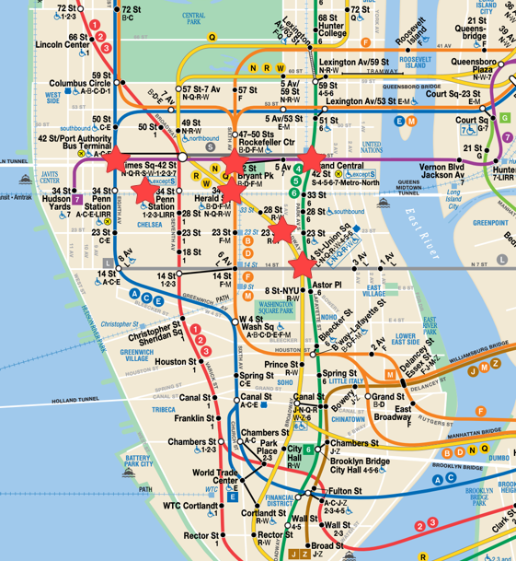
Recommendations
Street Teams Work:
At these stations:
34th St Penn Station
42nd St - Grand Central Station
42nd St
34th St - Herald Square
23rd St
14th St - Union Sq

Slide 8
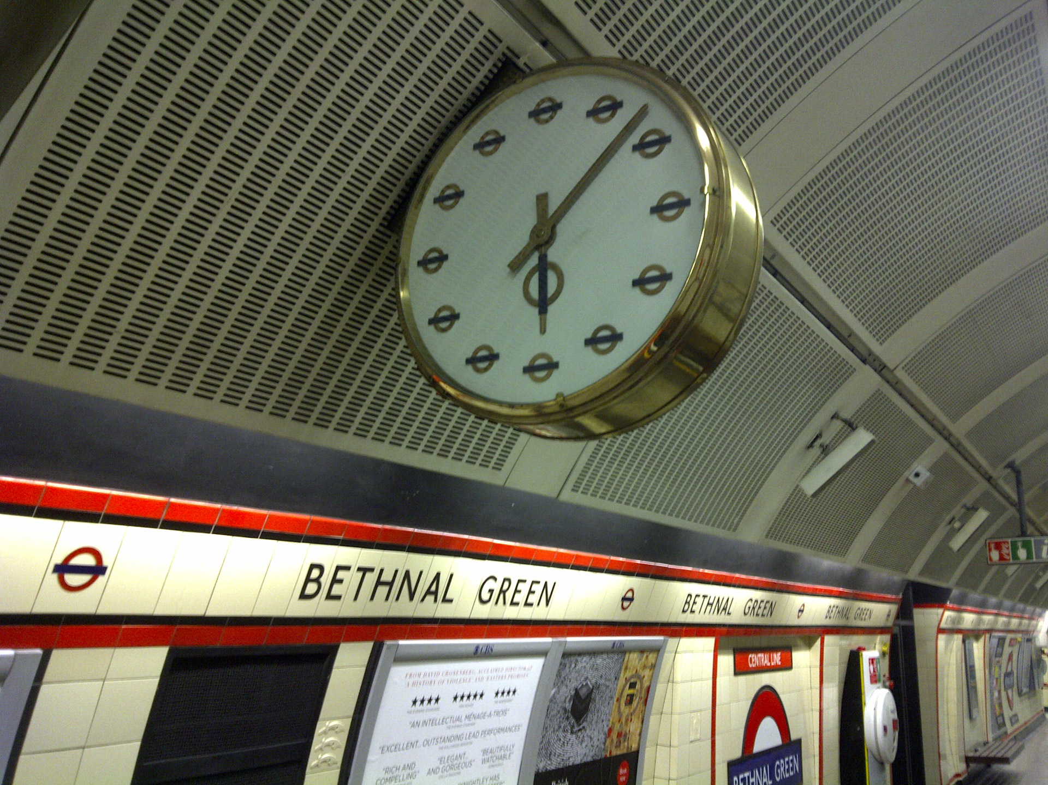
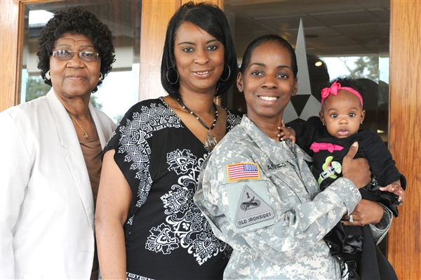



Future Work
Days / Times
Target
Specific
Areas
Demographics
Tech
Companies

Slide 9

Questions?
Notes:
Conclusion:
We had a lot of fun wrangling the mta data and coming up with these simple plots. Based on your interests and scope, we can go ahead with anything discussed above, or meet to iterate on these themes. We’re really looking forward to working with you! Women in tech is an issue we love to support.

Slide 10
Appendix

Slide 11
Results
High Traffic + Near Tech Hubs
High Traffic
High Traffic + Near Tech Hubs
Near Tech Hubs

Slide 12
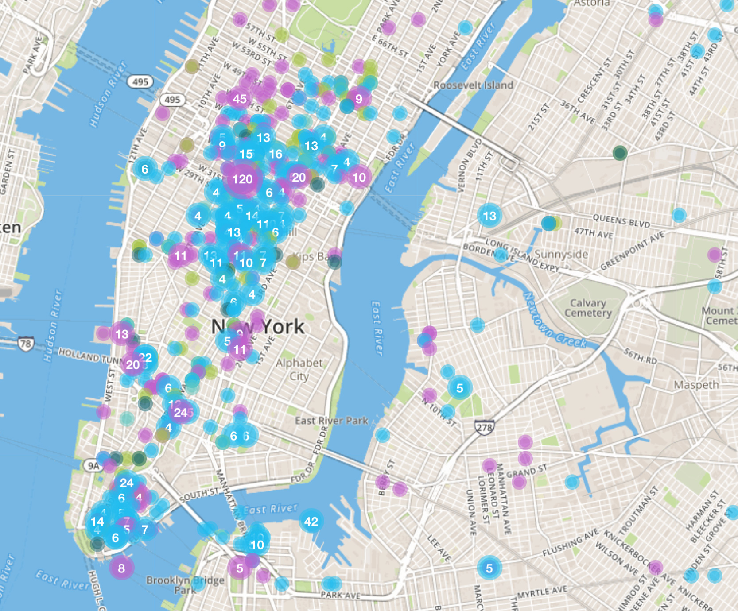
NYC Tech Scene
Digital NYC: http://www.digital.nyc/map

Slide 13
NYC Tech Scene
Digital NYC: http://www.digital.nyc/map
10001 $660 M
10011 $586 M
10010 $365 M
10007 $254 M
10016 $185 M
10018 $173 M
10036 $171 M
10013 $156 M
10012 $157 M
10014 $78 M
Built IN NYC: https://www.builtinnyc.com/2016/08/09/nyc-fundings-zipcode-2016

Slide 14
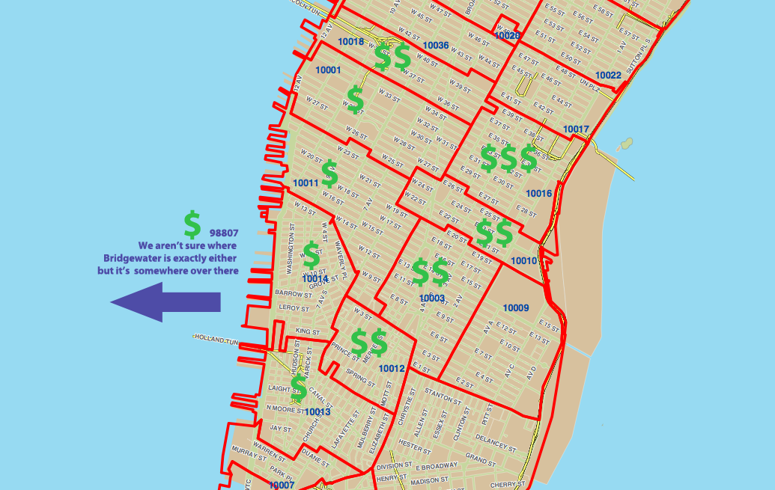
NYC Tech Scene
1. 10016
2. 10010
3. 10012
4. 10003
5. 10018
6. 10011
7. 10013
8. 10001
9. 08807
10. 10014
Alley Watch: https://www.alleywatch.com/2013/09/the-10-nyc-zip-codes-getting-the-most-vc-investment/

Slide 15
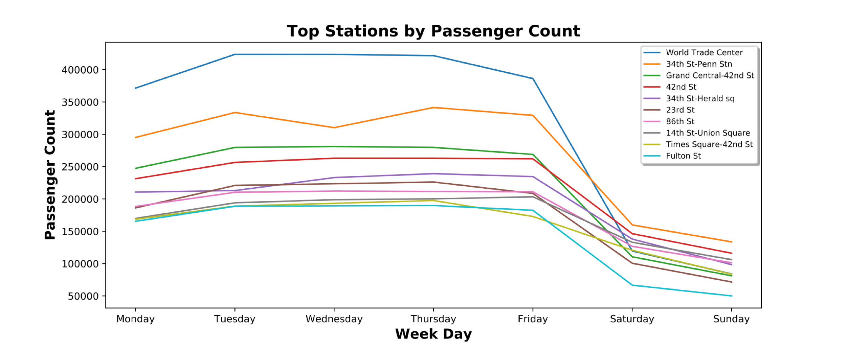
Weekdays

Slide 16
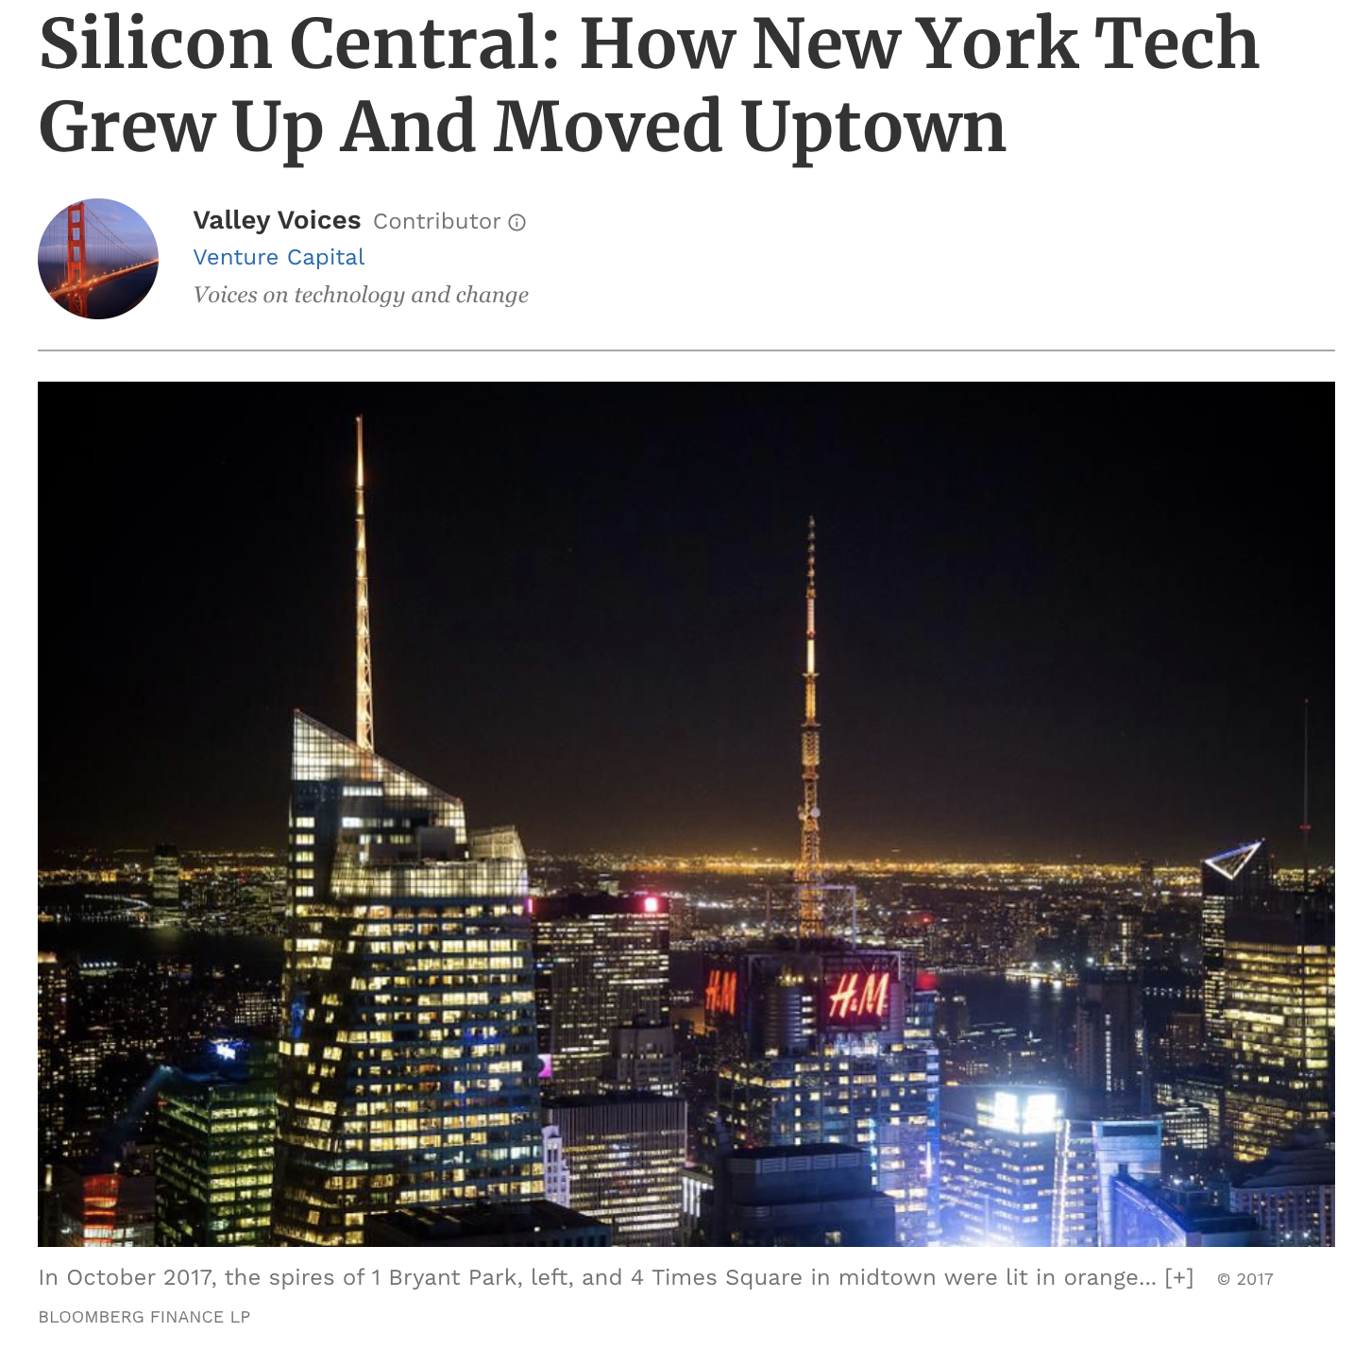
https://www.forbes.com/sites/valleyvoices/2019/03/27/how-new-york-tech-grew-up-and-moved-uptown/#f73ff9b41bfd
Notes:
Flatiron District – notable businesses
Some businesses have moved to the blocks circumventing Bryant Park and Grand Central Terminal, which the author dubbed as ‘Silicon Central’

Slide 17
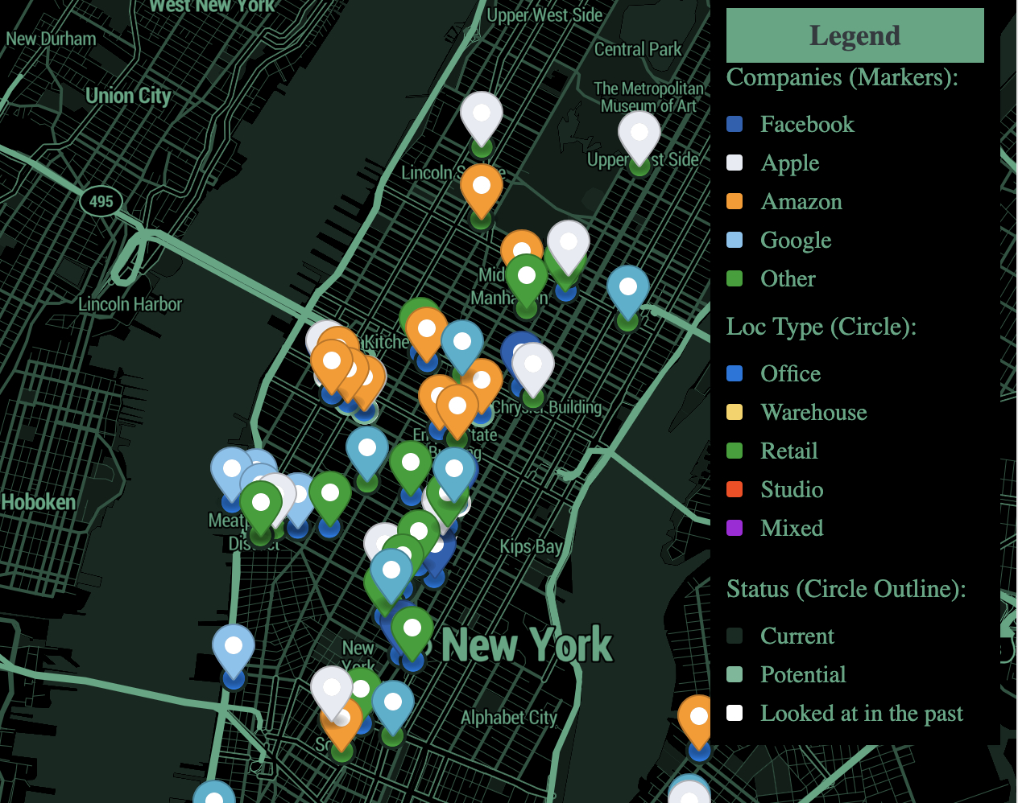
NYC Tech Scene
15% of Manhattan office space.
The Real Deal (NYC Real Estate News): https://therealdeal.com/2019/08/23/map-heres-a-look-at-all-the-big-tech-locations-in-nyc/

